Slide 1
Quarterly Meeting
South Florida Chapter
March 31, 2022

Slide 2
Agenda
Recruitment and Membership
Communications and Potential Activities
Asset Management Discussion
Role of Leadership
How to Write an Asset Management Policy

Slide 3
Recruitment and Membership
Free to join: https://theiam.org
Organized by Chapters
Why Join
Benefits
Membership
Interested in asset management
Develop understanding of asset management
Exposure to industry leaders
Be part of a growing network of professionals
Access to publications, references, webinars, conferences, discussions
Opportunities to contribute to the asset management body of knowledge
Be recognized as an asset management professional
Progress through different memberships to reflect asset management journey
Student
Actively studying asset management
Associate
No prerequisites
Member (MIAM)
Experience and Proposer support required
Fellow (FIAM)
Leadership experience and two Proposers required

Slide 4
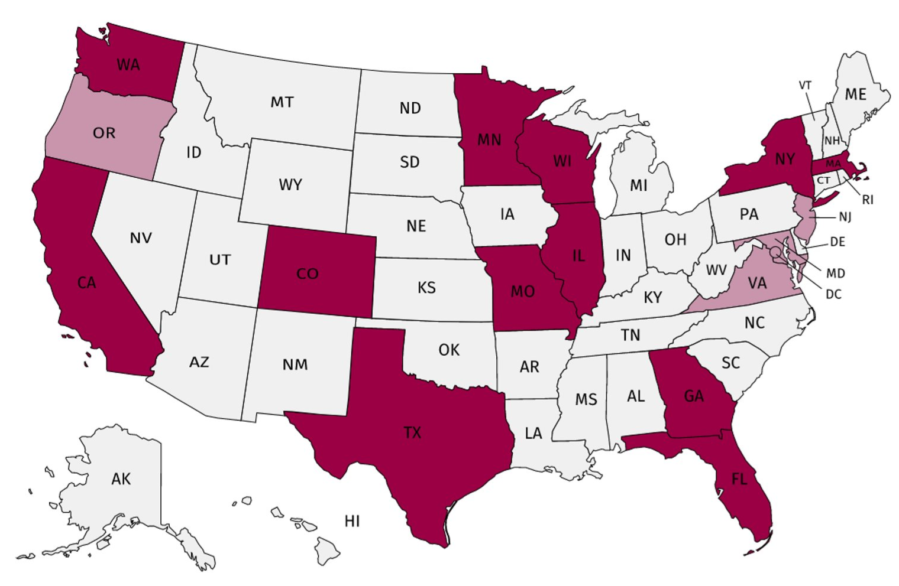
Recruitment and Membership
USA Chapters
8-member Executive Committee
13 established branches, 3 potential chapters
Active NxtGen & Women in Asset Management Groups
-500 members nationwide

Slide 5
South Florida Chapter
Leads:
John Acton
Anthony Armeli
Melody Tungol
Requirements for Leads:
Active membership to IAM (paid)
Commitment to advance the asset management profession and practice

Slide 6
Communications and Activities
Emails will be sent out by Melody or via IAM
Quarterly meetings posted on IAM Website
Dates:
June 30
September 29
December 15
Activities:
Focus Group Discussions
Mentorship Program
Site Visits

Slide 7
Communications and Activities
Call for Volunteers
Take minutes, coordinate activities
If interested:
Contact Melody
mtungol@pbcwater.com

Slide 8
The Role of Leadership
Asset Management Discussion

Slide 9
The Role of Leadership
“Leadership and commitment from all managerial levels is essential for successfully establishing, operating, and improving asset management within the organization.”
ISO 55000, 2.4.2
Management vs Leadership
Author Stephen Covey described the difference in these terms: “Management is efficiency in climbing the ladder of success; leadership determines whether the ladder is leaning against the right wall.”
Managing:
Doing things right
Leading:
Doing the right things

Slide 10
Why is Leadership Important in Asset Management?
ISO 55001 looks at the management of assets within an organization in order to ensure alignment with the overall strategic objectives. The single most important factor in the successful implementation of an Asset Management System is the buy in from Top Management and the leadership team.

Slide 11
How is this accomplished?
Set the direction for the organization
Vision
Mission
Goals
Establish principles and criteria for making decisions
Policy
Create a culture and environment reflecting an organization wide commitment to asset management
Culture

Slide 12
How is this accomplished?
Define the structure of the organization that shows the roles and responsibilities
RACI Matrix
Provide resources to get things done
Commitment
Provide guidance on key issues and benefits of asset management
Subject
Matter
Experts

Slide 13
Leadership Screenshot
Successful asset management depends on leaders who have personal values that align with the organization’s vision and policy regarding these efforts and a responsibility to achieve the organization’s goals.
Line of Sight
Value Realization
Drive Decision Making and Continuous Improvement
Show Improved Performance
Manage and Mitigate Risks

Slide 14
Asset Management Discussion
How to Write an Asset Management Policy

Slide 15
What is an Asset Management Policy?
An asset management policy is one of the core requirements of ISO 55001 certification and a cornerstone of a solid and complete asset management strategy.
-Provides a set of guiding principles, intentions, goals, and methods for asset management.
(Asset Management Council: Companion Guide to ISO 55001)

Slide 16
Benefits of an Asset Management Policy
- Standardization and efficiency
Sets a strong direction and clear expectations
Shows consistency with organization’s strategic plan and overarching goals
Reliability and safety
Highlights best practices
Executive sponsorship
Makes everyone accountable
Creates allies within the organization
Shows commitment from leadership

Slide 17
How to Develop an Asset Management Policy?
- Intent
Communicate intended purpose and outcomes
Scope
Describe the assets and services covered
Principles
Provides direction
Responsibilities
Identify who is responsible for approving and leading the implementation of the policy

Slide 18
Elements in an Asset Management Policy
- Summarize the intent
First section
Sets the tone
Establish the aim clearly and succinctly
Tie asset management to the importance of achieving the goals/objectives of the organization
One to three sentences
State the scope
Describe the assets and services covered and people affected
Establish expectations and reinforce accountability
Max 5 sentences
Articulate the intended outcomes
Summarize the rationale behind the policy
Set specific objectives as it relates to assets and asset management (ex. Improved reliability or increased accountability)
Max 5 sentences

Slide 19
Elements in an Asset Management Policy?
- Define responsibilities
Review statement (frequency and date)
Approval
Show continual improvement and regulatory compliance
State commitment to continual improvement
Maintain compliance with third party standards
Strengthens the organization’s goal to improve in all areas
Max 4 sentences
Refer to additional resources (if needed)
List of administrative details and related documents
Signature of executive sponsors

Slide 20
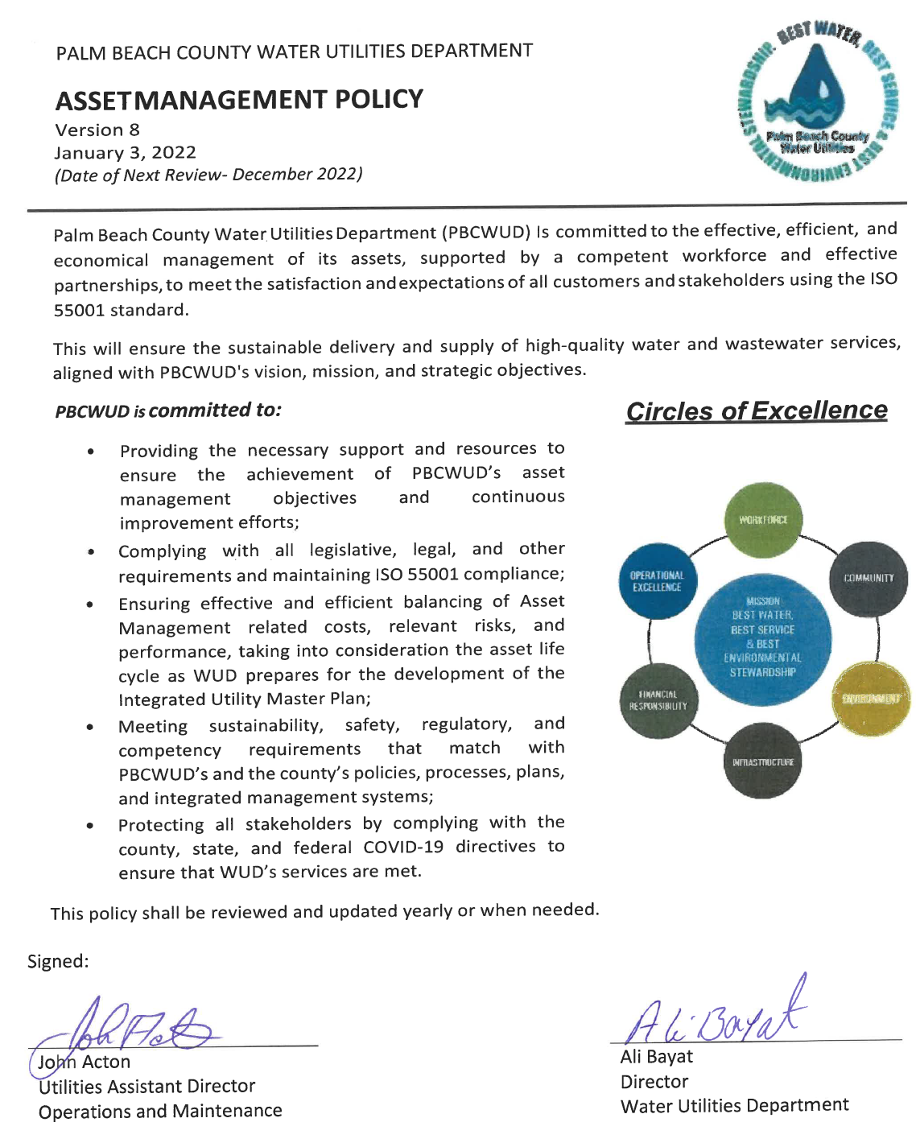
Example
Summarize intent
State the scope
Articulate the outcomes
Show continual improvement and regulatory compliance
Refer to additional resources
Define Responsibilities

Slide 21
Quarterly Meeting
South Florida Chapter
Next Meeting: June 30, 2022

